Slide 1
Data Structure Design (2018-02)
Wrap up & Documentation
Presenter . 박미지

Slide 2
0. Schedule
1. Testing Result
Contents
2. Documentation
3. Q&A

Slide 3
Schedule
Schedule | Under Progress
Under Standing Problems | Complete
Designing Problems | Complete
Solving problems | Complete
Experimentation | Complete
Testing | Done
Evaluation | Done
Wrapup & Documentation | Done
Schedule

Slide 4
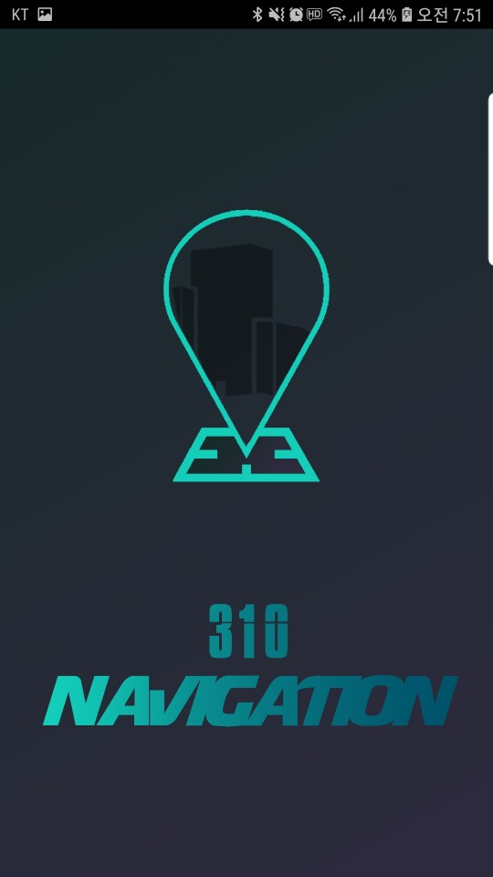
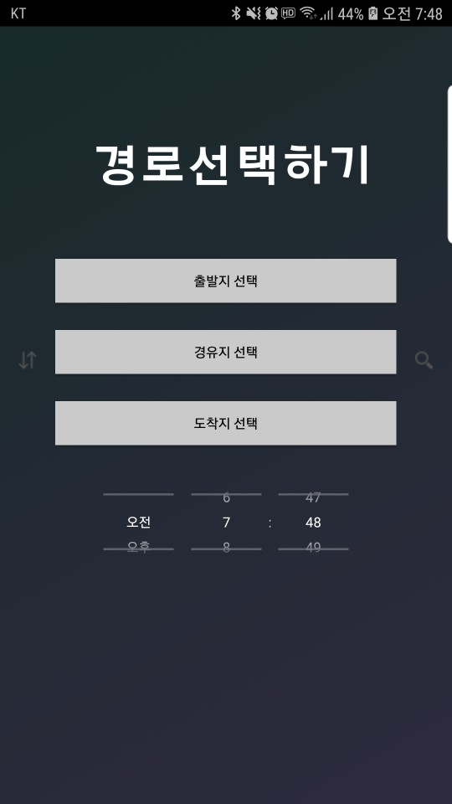
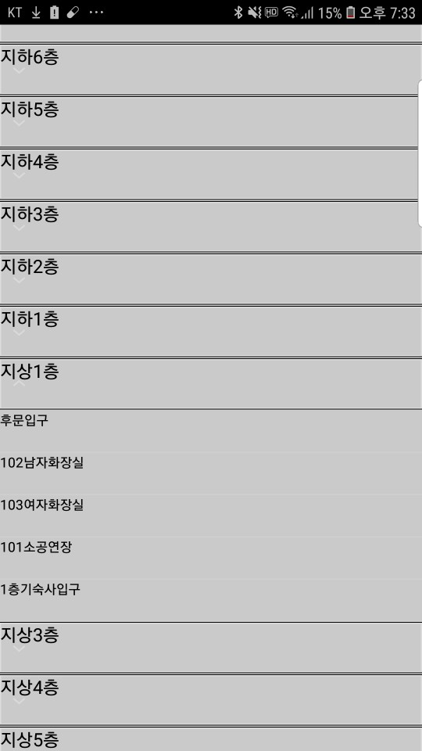
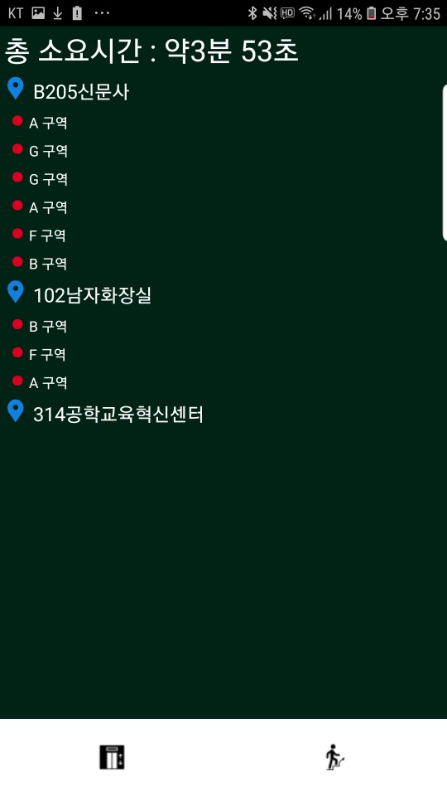
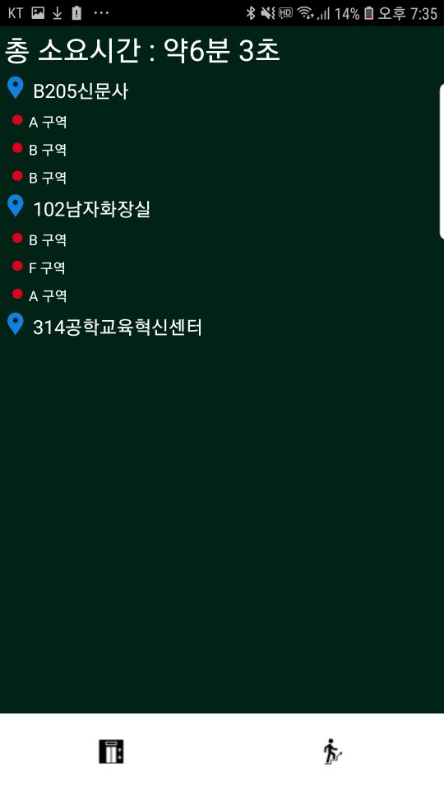
Result (UI)
Testing
Result
Testing Result
Documentation
Q & A

Slide 5
Testing Result (Total)
Testing
Result
Testing Result
Testing Case
후문입구
카우버거
727강의실
Documentation
Q & A

Slide 6

Documentation
Testing
Result
Testing Result
Documentation
Q & A
Google Docs를 이용 해 함께 작성 중

Slide 7
Q&A
Q&A
Testing Result
Documentation
Q & A
Thank you.

